Slide 1


Slide 2
Members
CEO - Rashaad Swanson
VP - Yanely Ramirez
PWA - International

Slide 3
Mission Statement
“To provide the highest quality web services at rates you can afford.”
PWA - International

Slide 4
About us
Headquarters: Orlando, FL
Established: 2009
Locations: Dubai, London, Paris, Rome, Rio
Employees: 10,000+
PWA - International

Slide 5
Services
HTML
JavaScript
CSS
Photoshop
Web Maintenance
PWA - International

Slide 6
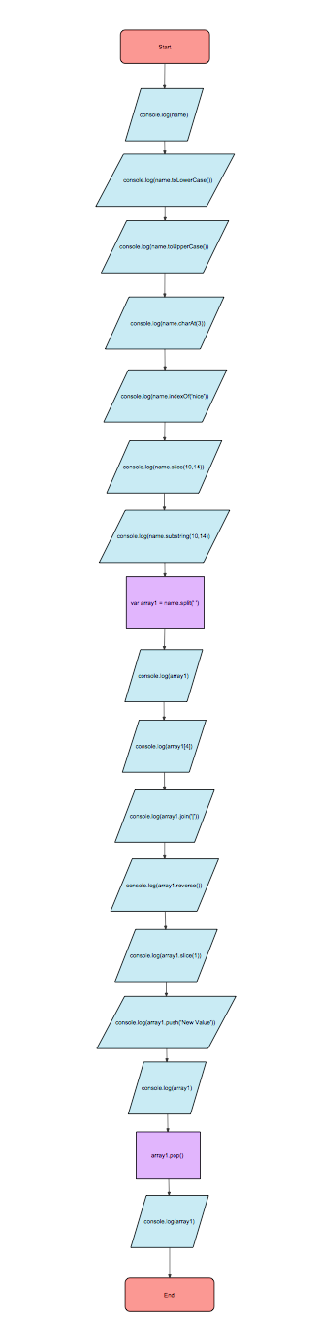
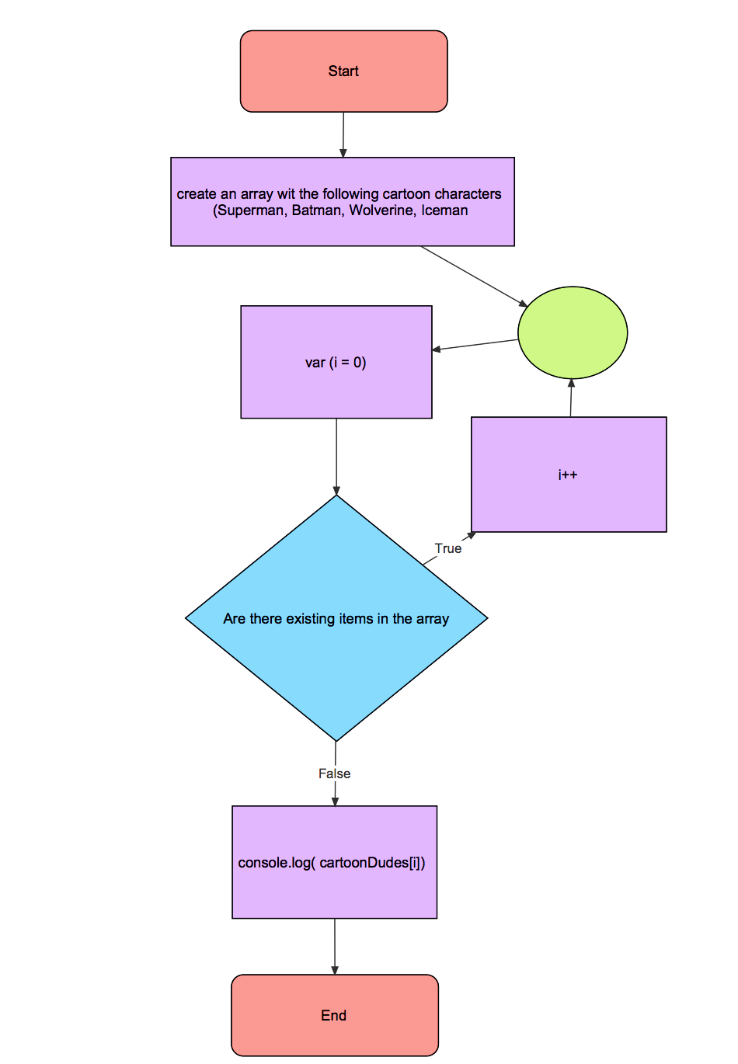
Flowchart Example

Slide 7
Prices
$50/hour*
When you sign up for three projects, you get the third one for 10% off.
Example:
1st project = $2,500
2nd project = $3,400
3rd project = $3,000 - 10% = $2,700
Grand Total Price: $8,600
* After 2nd revision of contract we have to charge by hour regardless of your budget
PWA - International

Slide 8




Clients
Simply Serenity Spa
PWA - International

Slide 9
Why choose us?
Money - Invest wisely
Outsourcing helps keep prices low and allows us to have representatives and tech help 24/7.
Low employee turnover
Forbes: Top 100 best places to work for.
Specializing helps focus better on what you want.
Work ethic: ADDIO
PWA - International

Slide 10
Hosting and Backup
Wix - Will be used to host your site (the host we use for all of our sites).
Github - Will be used for all backups.
Back-ups are done after every change.
FrontTech will log where they left off when project is handed over to another worker.
Portfolios:
http://wadeness23.wix.com/pwa1-portfolio
http://yxnely.wix.com/pwa1-portfolio
PWA - International

Slide 11
Testimonies
“Couldn’t have finished in time for the grand opening of my store if it weren’t for FrontTech. They really helped me finish a last minute project that also had quality.” -Jessica Roark (Simply Serenity Spa, Owner).
“We can always count on FrontTech to deliver clean, appealing designs.” -James Monroy (Apple, Head Designer).
“We had a problem with the checkout on our site, FrontTech helped solve that problem and with liability!” -Carrie Gregg (Amazon, Head Designer).
PWA - International

